Slide 1

Course Name: Hardware Security
Faculty Name: Prof Debdeep Mukhopadhyay
Department : Computer Science and Engineering
Topic
Lecture 28: Power Analysis-IV

Slide 2

Concepts Covered:
Noise in Power Traces
Statistical Analysis of Power Traces
Statistical Analysis of DoM

Slide 3
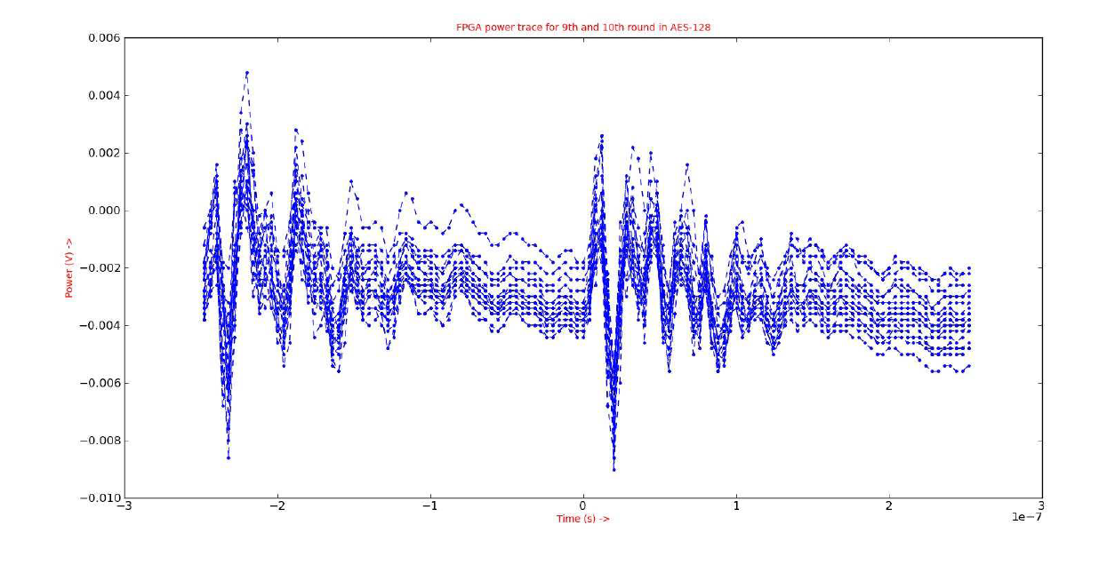
Quality of Measurement and Noise
High quality of power traces captured is central to the accuracy of DPA.
AES-128 Encryption with same plaintext and key, but resulting in different power traces.
These fluctuations are due to electrical noise, caused by noise due to power supply, clock generator, conduction and radiation emissions from the components connected to the device under attack.

Slide 4
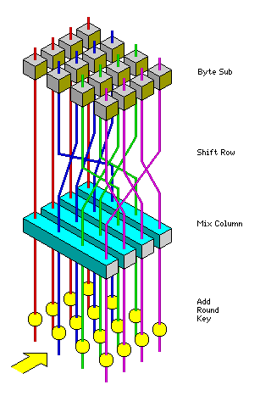
Algorithmic Noise
Algorithmic
Noise
Algorithmic or switching noise occurs because of contributions of logic cells to the power consumption, which are not under attack.
The power trace corresponds to the total power consumption of the circuit.
However, in the attack we target only a small part (see red circle in fig.) to reveal a portion of the key.
The power consumption from all the other parts (see blue shaded portion in fig.) form the algorithmic noise.
This would be more in a parallel implementation, compared to a serialized implementation.
Signal
Component

Slide 5
Quality of Probes
Power consumption of CMOS based cryptographic devices is an analog high-frequency (HF) signal, which means the frequency component or bandwidth of the power signals are in GHz range.
Measurement of such signals is challenging as they are affected in propagation from the logic cells on device to the oscilloscope by factors like filtering, cross talk, thermal noise, etc.
The parasitics in the mentioned path limit the bandwidth: due to bypass capacitances located in the power supply grid of the FPGA, and the parasitic inductances due to the bonding wires on the IO pads.
Filter out the high bandwidth components
The probes of the oscilloscope should have a bandwidth of more than 1 GHz and less than 4pF of capacitive loading: with such settings we can get a high bandwidth path for the power trace to propagate without degradation.

Slide 6
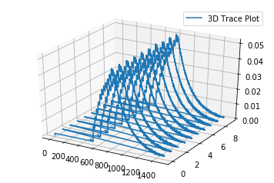
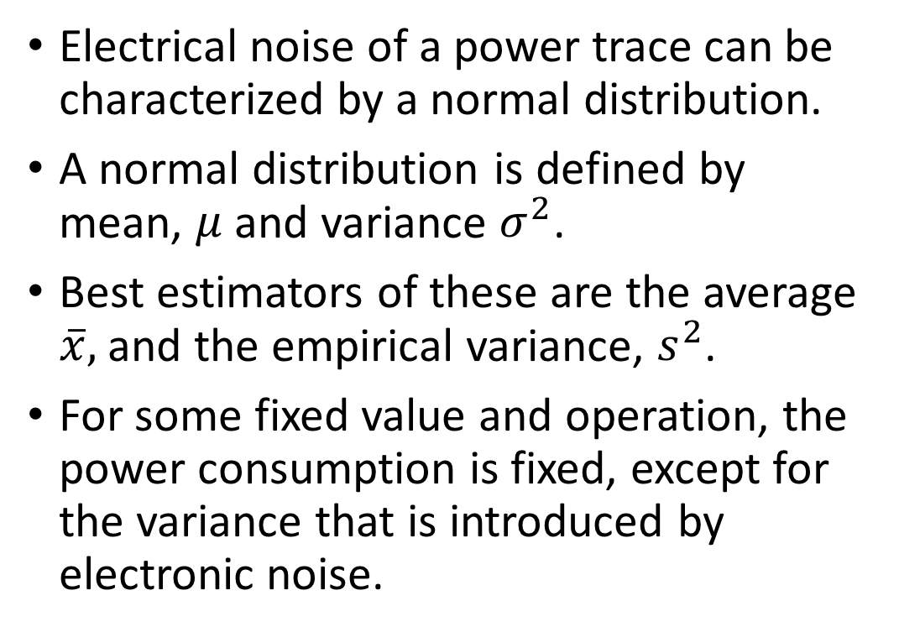
Statistical Analysis of Power Traces
Electrical noise of a power trace can be characterized by a normal distribution.
A normal distribution is defined by mean, $μ$ and variance $σ^{2}$.
Best estimators of these are the average $\overline{x},$ and the empirical variance, $s^{2}$.
For some fixed value and operation, the power consumption is fixed, except for the variance that is introduced by electronic noise.

Slide 7
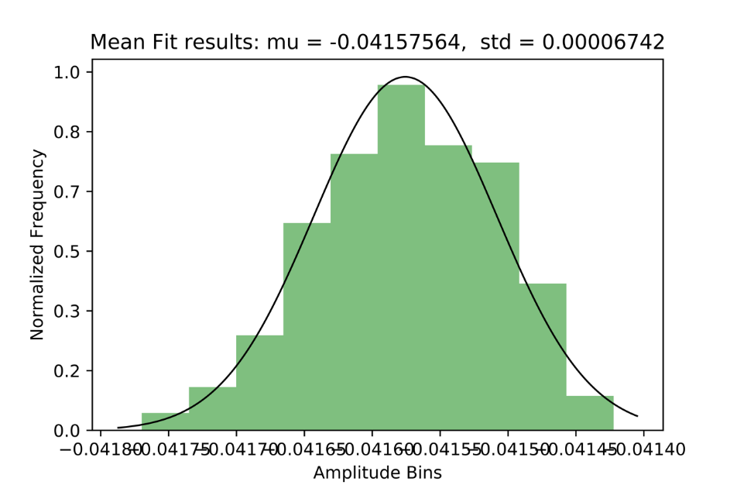
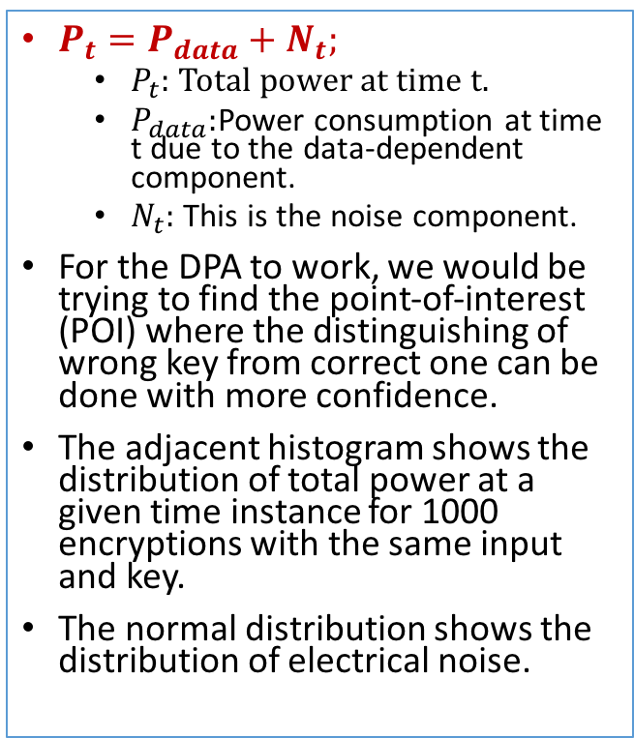
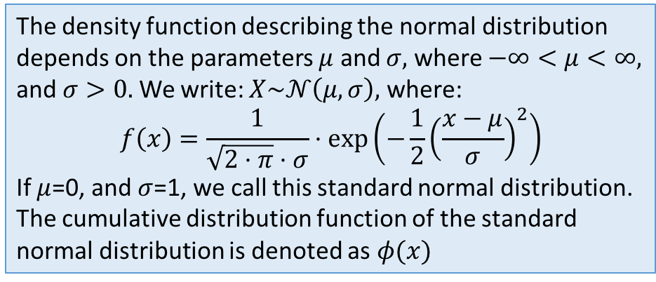
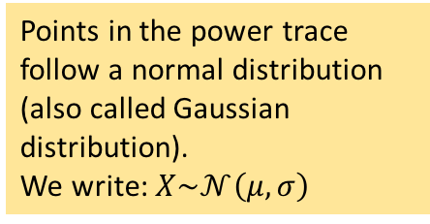
Components of Power Traces
$P_{t}=P_{data}+N_{t};$
$P_{t}:$Total power at time t.
$P_{data}:$Power consumption at time t due to the data-dependent component.
$N_{t}:$ This is the noise component.
For the DPA to work, we would be trying to find the point-of-interest (POI) where the distinguishing of wrong key from correct one can be done with more confidence.
The adjacent histogram shows the distribution of total power at a given time instance for 1000 encryptions with the same input and key.
The normal distribution shows the distribution of electrical noise.
Points in the power trace follow a normal distribution (also called Gaussian distribution).
We write: $X\sim 𝒩\left(μ,σ\right)$
The density function describing the normal distribution depends on the parameters $μ$ and $σ,$ where $−∞<μ<∞,$ and $σ>0.$ We write: $X\sim 𝒩\left(μ,σ\right),$ where:
$$f\left(x\right)=\frac{1}{\sqrt{2⋅π}⋅σ}⋅exp⁡\left(−\frac{1}{2}{\left(\frac{x−μ}{σ}\right)}^{2}\right)$$
If $μ$=0, and $σ$=1, we call this standard normal distribution.
The cumulative distribution function of the standard normal distribution is denoted as $φ(x)$

Slide 8
Sampling Distribution
Average value and standard deviation would change slightly for every experiment.
We can view the average and the empirical standard deviations as random variables.
Thus, mean value and the empirical standard deviation can be characterized by a probability distribution as well.
This concept is called sampling distribution.
Sampling distribution determines how well a certain parameter can be estimated.

Slide 9
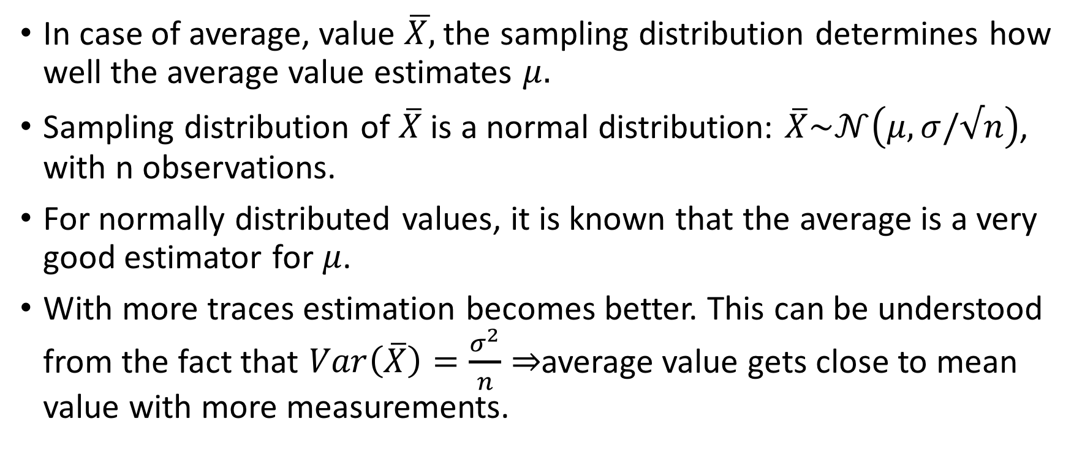
Sampling Distribution for Mean
In case of average, value $\overline{X,}$the sampling distribution determines how well the average value estimates $μ.$
Sampling distribution of $\overline{X}$ is a normal distribution: $\overline{X}\sim 𝒩\left(μ,σ/√n\right)$, with n observations.
For normally distributed values, it is known that the average is a very good estimator for $μ$.
With more traces estimation becomes better. This can be understood from the fact that $Var\left(\overline{X}\right)=\frac{σ^{2}}{n}⇒$average value gets close to mean value with more measurements.

Slide 10
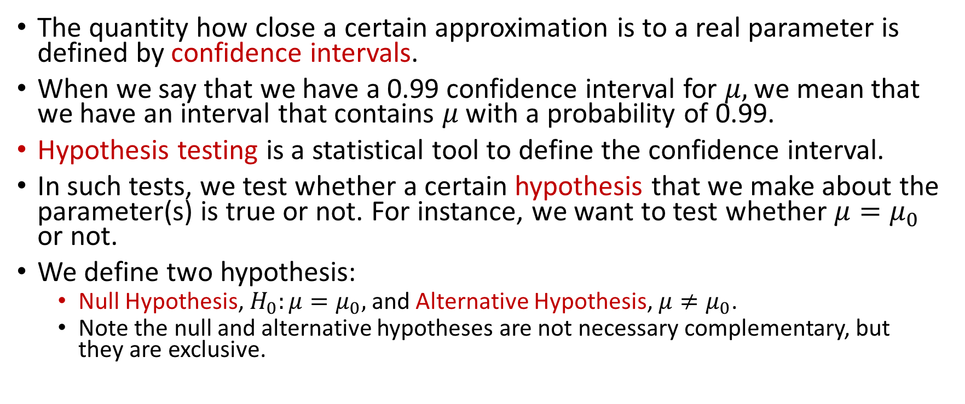
Confidence Intervals and Hypothesis Testing
The quantity how close a certain approximation is to a real parameter is defined by confidence intervals.
When we say that we have a 0.99 confidence interval for $μ,$we mean that we have an interval that contains $μ$ with a probability of 0.99.
Hypothesis testing is a statistical tool to define the confidence interval.
In such tests, we test whether a certain hypothesis that we make about the parameter(s) is true or not. For instance, we want to test whether $μ=μ_{0}$ or not.
We define two hypothesis:
Null Hypothesis, $H_{0}:μ=μ_{0},$and Alternative Hypothesis, $μ≠μ_{0}$.
Note the null and alternative hypotheses are not necessary complementary, but they are exclusive.

Slide 11
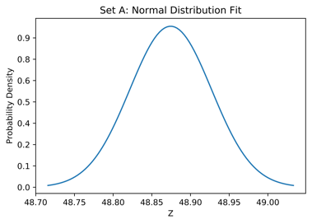
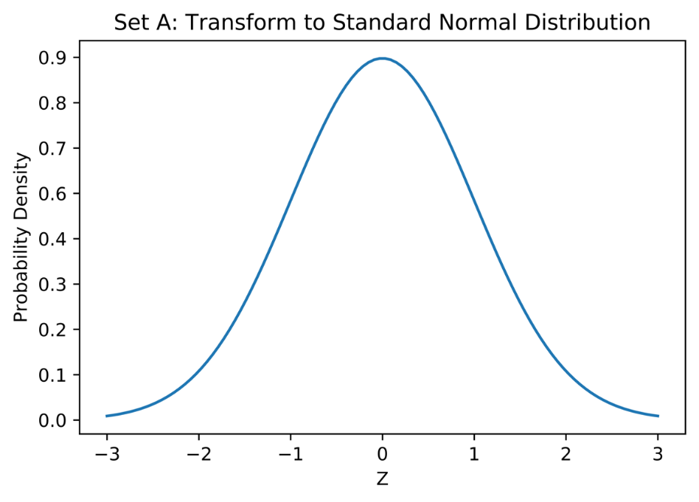

Transforming from Normal to Standard Normal Distribution
Say we have a sampling distribution for some mean: $\overline{X}\sim 𝒩\left(μ,σ/√n\right)$.
Then define $Z=\left(\overline{X}−μ\right)⋅\frac{√n}{σ}$ is a standard normal distribution.

Slide 12
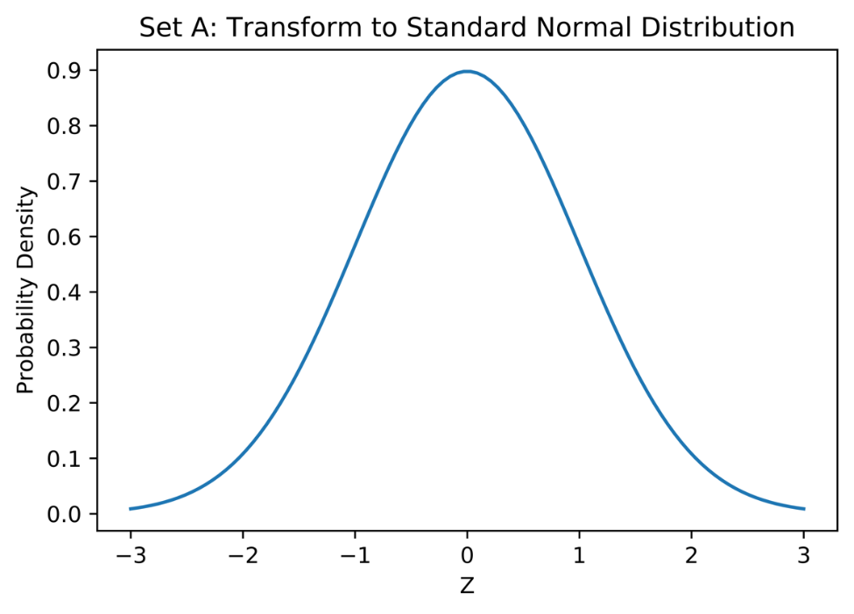
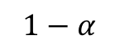
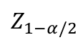
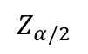
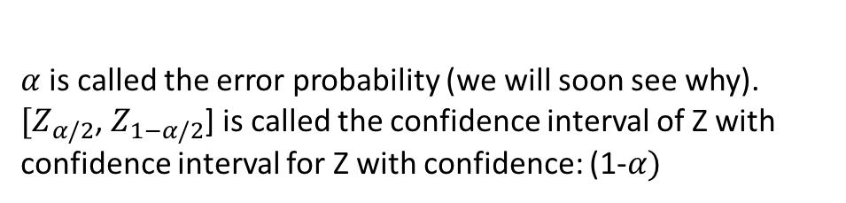
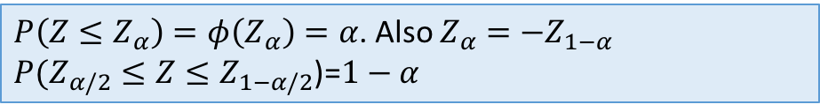
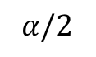

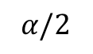
Characteristic of a Standard Normal Distribution
$P\left(Z≤Z_{α}\right)=φ\left(Z_{α}\right)=α$. Also $Z_{α}=−Z_{1−α}$
$P(Z_{α/2}≤Z≤Z_{1−α/2}$)=$1−α$
$$1−α$$
$α$is called the error probability (we will soon see why).
$[Z_{α/2}$, $Z_{1−α/2}$] is called the confidence interval of Z with confidence interval for Z with confidence: (1-$α)$
$$α/2$$
$$α/2$$
$$Z_{α/2}$$
$$Z_{1−α/2}$$
$$α$$ | 0.800 | 0.850 | 0.900 | 0.950 | 0.975 | 0.990 | 0.995 | 0.999 | 0.9999
$$z_{α}$$ | 0.842 | 1.036 | 1.282 | 1.645 | 1.960 | 2.326 | 2.576 | 3.090 | 3.7190
Quantiles $z_{α}$ of the $𝒩\left(0,1\right)$distribution for some values of $α$.

Slide 13
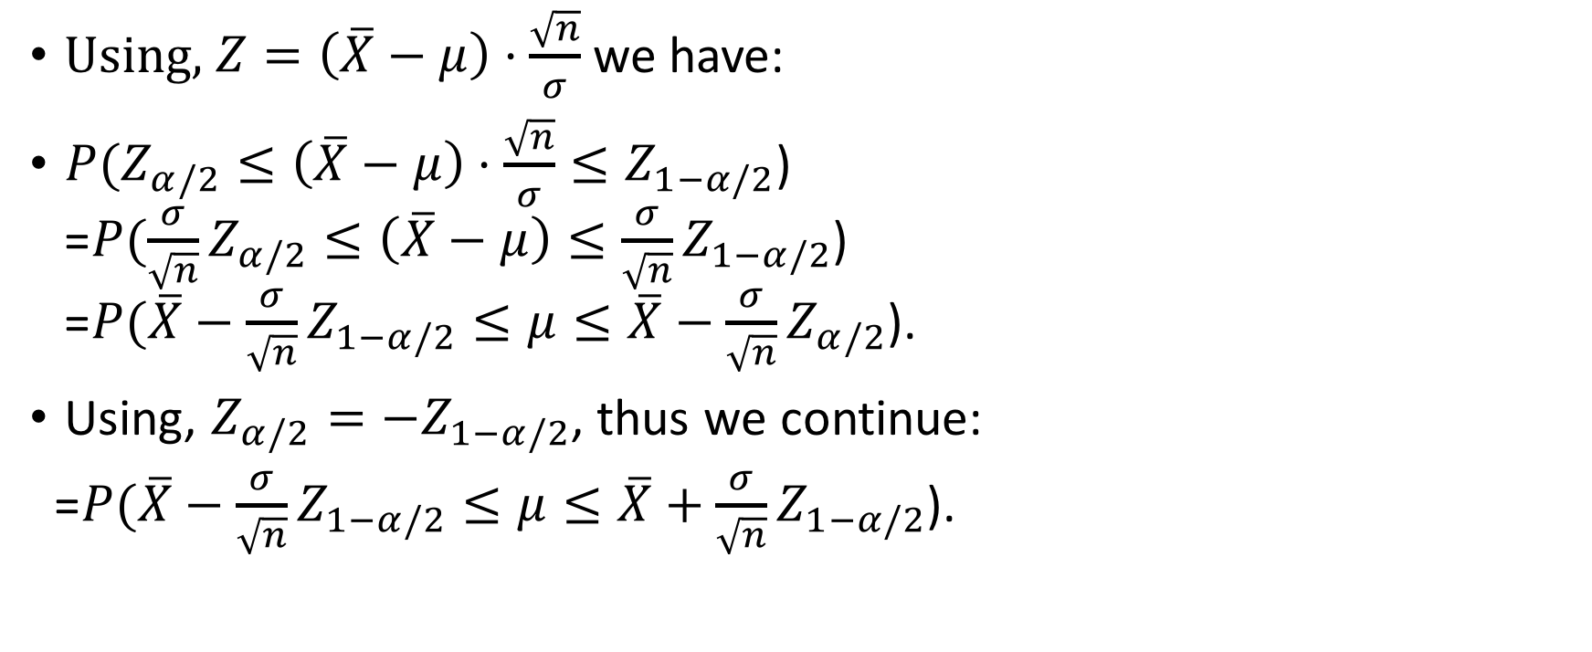

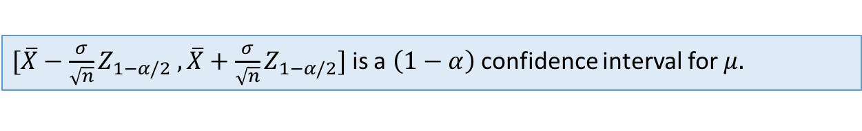
Derive the Confidence Interval for $μ$
Using, $Z=\left(\overline{X}−μ\right)⋅\frac{\sqrt{n}}{σ}$we have:
${P(Z}_{α/2}≤\left(\overline{X}−μ\right)⋅\frac{\sqrt{n}}{σ}≤Z_{1−α/2}$) =${P(\frac{σ}{\sqrt{n}}Z}_{α/2}≤\left(\overline{X}−μ\right)≤{\frac{σ}{\sqrt{n}}Z}_{1−α/2}$) =${P(\overline{X}−\frac{σ}{\sqrt{n}}Z}_{1−α/2}≤μ≤\overline{X}−\frac{σ}{\sqrt{n}}Z_{α/2}$).
Using, $Z_{α/2}=−Z_{1−α/2}$, thus we continue:
=${P(\overline{X}−\frac{σ}{\sqrt{n}}Z}_{1−α/2}≤μ≤\overline{X}+\frac{σ}{\sqrt{n}}Z_{1−α/2}$).
$[{\overline{X}−\frac{σ}{\sqrt{n}}Z}_{1−α/2} ,\overline{X}+\frac{σ}{\sqrt{n}}Z_{1−α/2}]$ is a $\left(1−α\right)$ confidence interval for $μ.$

Slide 14
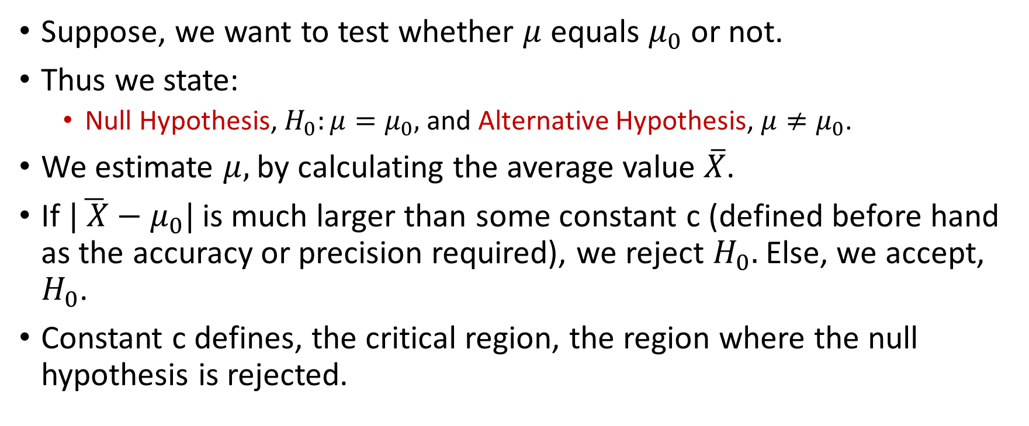
Hypothesis Test
Suppose, we want to test whether $μ$ equals $μ_{0}$ or not.
Thus we state:
Null Hypothesis, $H_{0}:μ=μ_{0},$and Alternative Hypothesis, $μ≠μ_{0}$.
We estimate $μ,$by calculating the average value $\overline{X}$.
If $|\overline{ X}−μ_{0}|$ is much larger than some constant c (defined before hand as the accuracy or precision required), we reject $H_{0}.$ Else, we accept, $H_{0}$.
Constant c defines, the critical region, the region where the null hypothesis is rejected.

Slide 15
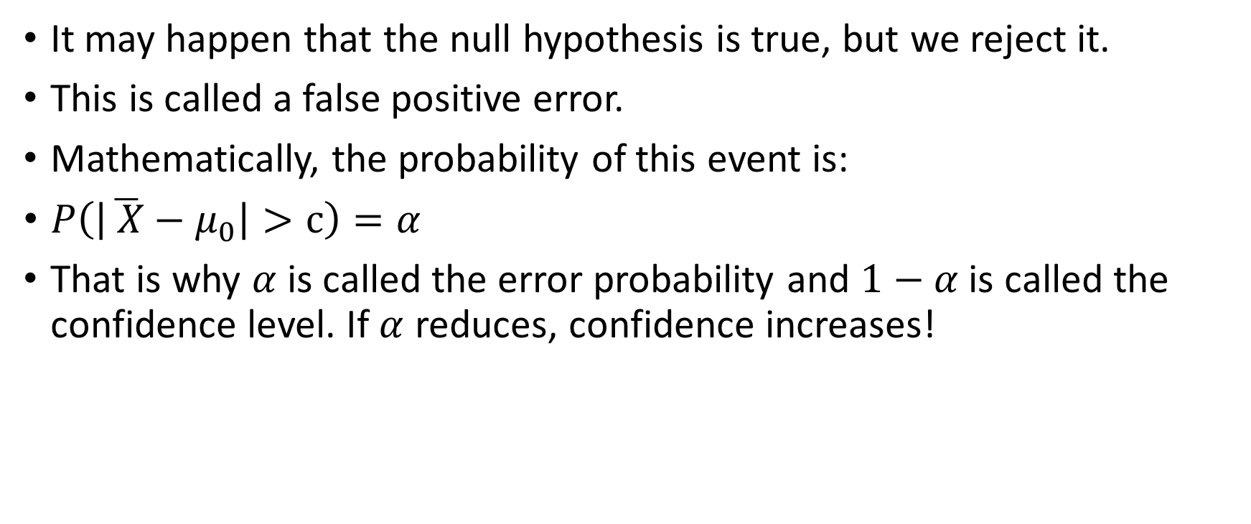
False Positive Error
It may happen that the null hypothesis is true, but we reject it.
This is called a false positive error.
Mathematically, the probability of this event is:
$P\left(\left|\overline{ X}−μ_{0}\right|>c\right)=α$
That is why $α$ is called the error probability and $1−α$ is called the confidence level. If $α$ reduces, confidence increases!

Slide 16
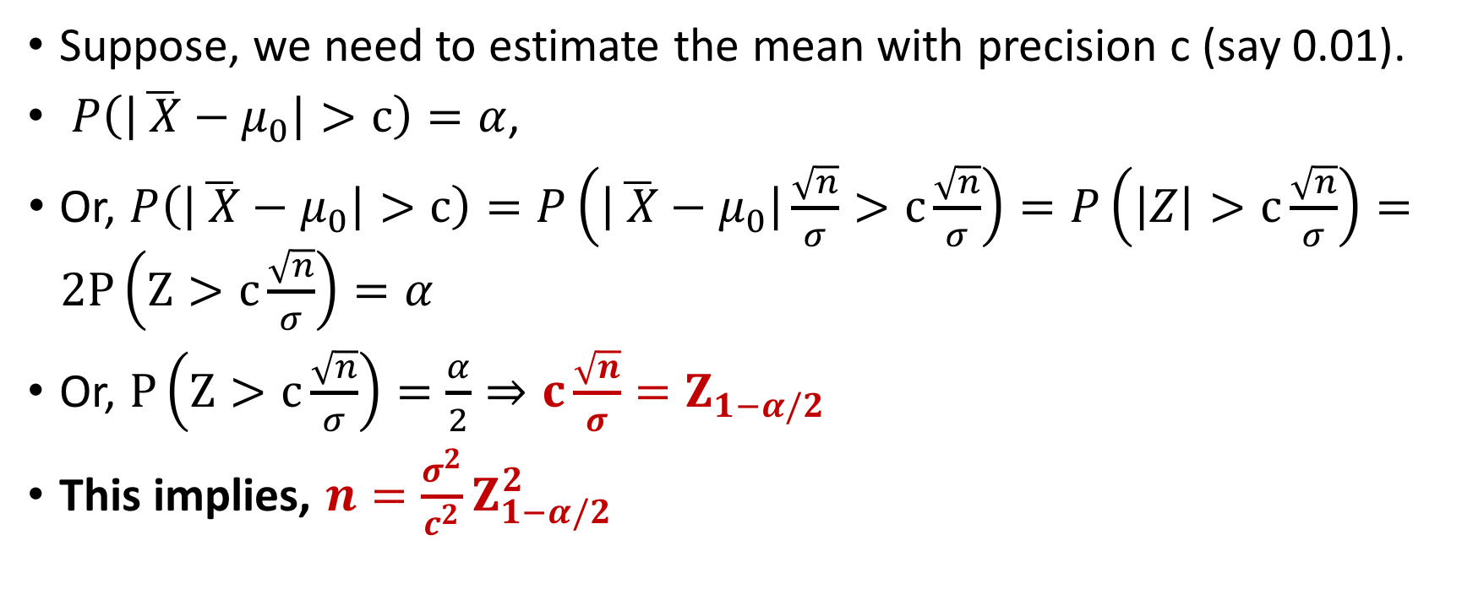
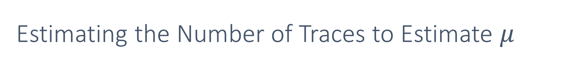
Estimating the Number of Traces to Estimate $μ$
Suppose, we need to estimate the mean with precision c (say 0.01).
$P\left(\left|\overline{ X}−μ_{0}\right|>c\right)=α$,
Or, $P\left(\left|\overline{ X}−μ_{0}\right|>c\right)=P\left(\left|\overline{ X}−μ_{0}\right|\frac{\sqrt{n}}{σ}>c\frac{\sqrt{n}}{σ}\right)=P\left(\left|Z\right|>c\frac{\sqrt{n}}{σ}\right)=2P\left(Z>c\frac{\sqrt{n}}{σ}\right)=α$
Or, $P\left(Z>c\frac{\sqrt{n}}{σ}\right)=\frac{α}{2}⇒c\frac{\sqrt{n}}{σ}=Z_{1−α/2}$
This implies, $n=\frac{σ^{2}}{c^{2}}Z_{1−α/2}^{2}$

Slide 17

Stefan Mangard, Elisabeth Oswald, Thomas Popp, Power Analysis Attacks: Revealing the Secrets of Smart Cards

Slide 18


